Slide 1
BUILDING WAF USING MACHINE
LEARNING MODELS

Slide 2
Table of contents
Introduction
Problem statement
Dataset
Model selection
Model training and evaluation
Results and performance
Model deployment and integration
Future works
Conclusions
QA and Thank you!

Slide 3
Introduction
A Web Application Firewall (WAF) is a security solution designed to protect web applications from malicious attacks and vulnerabilities.
Importance of WAF
Safeguarding against known vulnerabilities.
Defense against zero-day attacks.
Protection for sensitive data.
Mitigation of distributed denial-of-service (DDoS) attacks
Compliance with regulatory requirements.
Reputation management.
Continuous monitoring and threat intelligence.

Slide 4
Purpose of the presentation
In this presentation, our purpose is to explore and discuss the concept of building Web Application Firewall (WAF) rules using Machine Learning (ML) techniques.

Slide 5
Problem statements
The increasing complexity and sophistication of web-based attacks pose significant challenges to the security of web applications.
Traditional rule-based Web Application Firewalls (WAFs) struggle to keep up with emerging attack patterns, resulting in false positives, false negatives, and inadequate protection.
Limitations of Rule-based WAFs
Evolving Attack Landscape
High False Positive Rates
Inefficient Rule Management
Need for Accurate and Adaptive Protection.

Slide 6
Dataset
To train and evaluate the effectiveness of Machine Learning (ML) techniques for building Web Application Firewall (WAF) rules, a suitable dataset is required.
The dataset serves as the foundation for training the ML models and validating their performance.
Dataset Selection
Examples of Datasets
Dataset Preparation
Dataset Size and Distribution

Slide 7
Dataset selection
Various datasets are available for WAF research, each with its own characteristics and focus.
The selection of a dataset depends on the specific goals and requirements of the research.

Slide 8
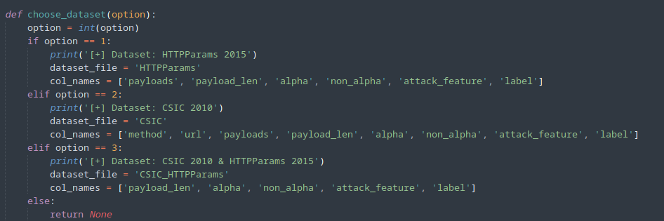
Examples of datasets used
HTTPParams 2015
CSIC 2010
CSIC 2010 & HTTPParams 2015

Slide 9
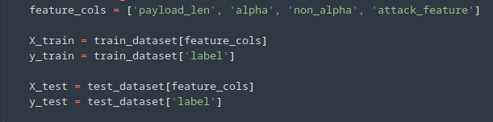
Dataset preparation
The selected dataset is preprocessed to extract relevant features and ensure data quality.

Slide 10
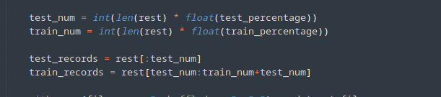
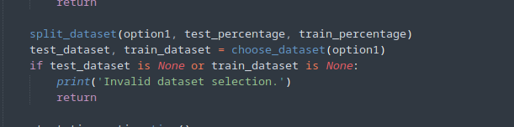
Dataset Size and Distribution
test_num represents the number of records allocated for testing
train_num represents the number of records allocated for training.
The dataset distribution in terms of normal and malicious requests can be assumed to be proportional to the original dataset, as the split_dataset function performs a random shuffle to maintain the distribution of records

Slide 11
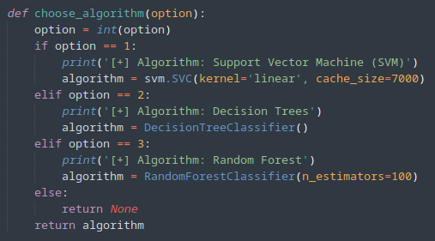
Model selection
The choose_algorithm function takes an option as input, which represents the algorithm choice made by the user.The option is converted to an integer using int(option)
The model selection process allows the user to choose the desired algorithm for training and testing the Web Application Firewall (WAF) model. The code provides options for SVM, Decision Trees, and Random Forest algorithms.

Slide 12
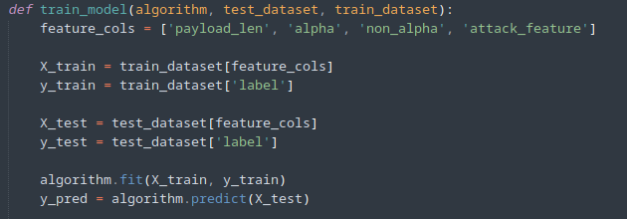
Model training
The train_model function takes the selected algorithm, test dataset, and train dataset as input.
The feature columns (payload_len, alpha, non_alpha, attack_feature) and target variable (label) are extracted from the train dataset.
The training data (X_train, y_train) and test data (X_test, y_test) are prepared using the extracted feature columns and target variable.
The selected algorithm is trained using the training data:algorithm.fit(X_train, y_train)
The trained algorithm is used to predict the labels for the test data:y_pred = algorithm.predict(X_test)

Slide 13
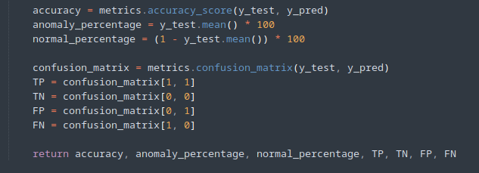
Model evaluation
The accuracy of the model is calculated by comparing the predicted labels (y_pred) with the actual labels (y_test):accuracy = metrics.accuracy_score(y_test, y_pred)
Other evaluation metrics such as confusion matrix, true positives (TP), true negatives (TN), false positives (FP), and false negatives (FN) are calculated using the predicted labels and actual labels:

Slide 14
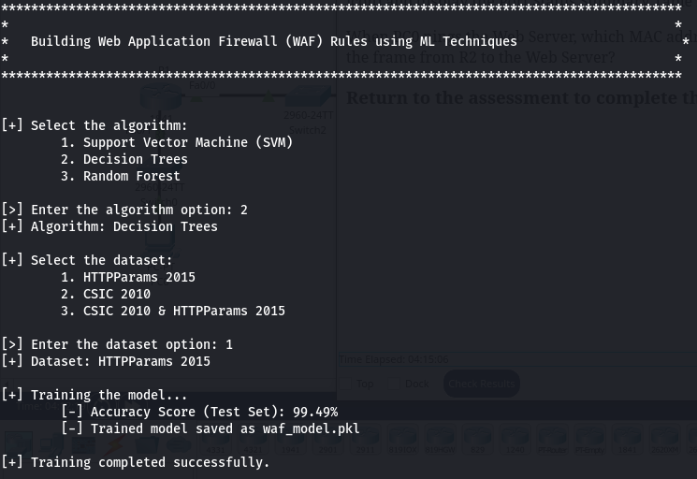

Slide 16
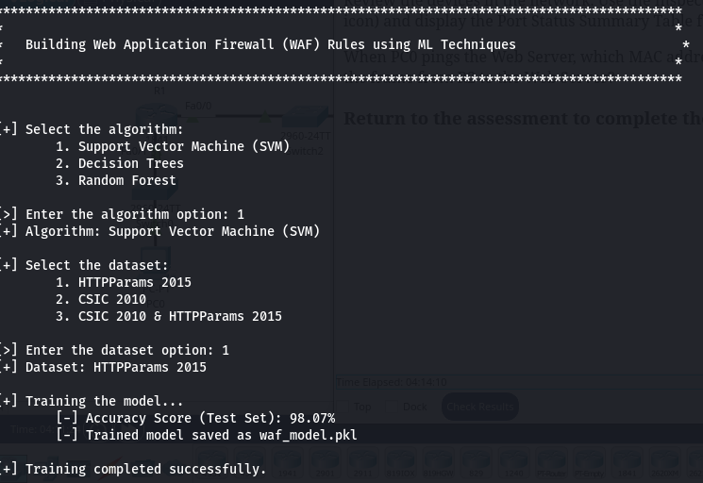

Slide 17
Model deployment and integration
To integrate the Web Application Firewall (WAF) with the trained model,
Load the Trained Model,In the WAF system, load the serialized trained model using a suitable library like joblib or pickle.
Capture Incoming Requests.
Extract Features.
Make Predictions.
Apply WAF Rules.
Log and Monitor.
Alert and Reporting.
Fine-tuning and Maintenance.

Slide 18
Future works
Improved Feature Engineering.
Ensemble Learning
Real-Time Monitoring and Analysis
Anomaly Detection
Adaptive Learning and Continuous Training
Integration with Threat Intelligence
Explainability and Interpretability
Cloud-Native WAF
User Behavior Analysis
Threat Hunting and Response Automation

Slide 19
Conclusions
We explore the waf application build using machine learning algorithms
Key findings
Improved Accuracy
Real-time Threat Detection
Adaptability to Emerging Threats
Feature Engineering
Algorithm Selection
Continuous Improvement

Slide 20
ML-based WAF systems have shown great promise in enhancing web application security by improving accuracy, enabling real-time threat detection, and adapting to emerging threats.
The project's findings demonstrate the potential of ML techniques in augmenting traditional WAF approaches and mitigating sophisticated attacks.
Continued research and development efforts are crucial to refine and advance ML-based WAF systems, making them more effective and adaptive in securing web applications.
Implementing ML-based WAF solutions can contribute significantly to strengthening the overall security posture of web applications and protecting sensitive data from malicious activities.

Slide 21
QA & Thank You !

